Slide 1



Two Dimensional Graphics
(2D Graphics)
Reference: Java-Tutorials/tutorial-2015/2d/index.html

Slide 2
Contents
Introduction to Java Graphics
Graphics Overview
Introduction to Java 2D Graphics
2D Graphics APIs
How to Draw?
Demonstrations

Slide 3
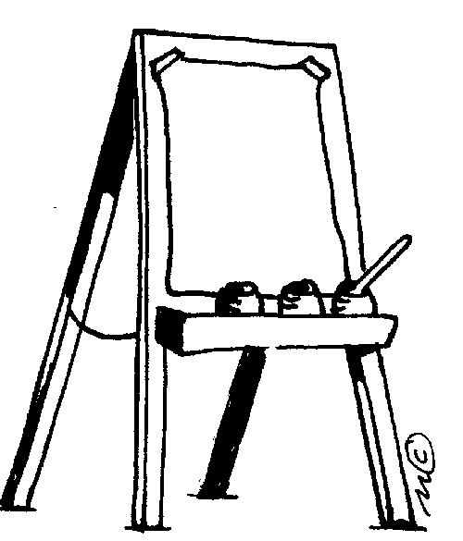
Introduction to Java Graphics
AWT/Swing come with lots of components that you can use to implement a fully-featured GUI.
But there are cases when you need a custom component.
  Usually this is when you want to paint custom 2-D graphics.
  We often call a custom painted component a canvas.
To do so, write a class that extends JComponent or JPanel.
  Override method paint to tell Java how to draw it:
  public void paint(Graphics g)
    Some programmers extend JPanel rather than JComponent .

Slide 4
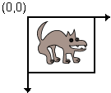
A drawing canvas
Coordinate system: (0, 0) at top-left,
x-axis increases rightward, y-axis downward.
Component's surface is transparent unless drawn on.
JPanel's paint does important things that we don't want to lose. (e.g. paints the component's background)
  So call the method super.paint first thing.
  public void paint(Graphics g) {
  super.paint(g);
  ...
  }

Slide 5
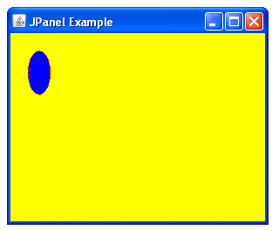
Quick drawing example
class MyCanvas extends JPanel {
public void paint(Graphics g) {
super.paint(g); // (1)
setBackground(Color.YELLOW); // without (1) no effect
//g.drawOval(int x, int y, int width, int height)
g.setColor(Color.RED);
g.drawOval(20, 20, 25, 50);
g.setColor(Color.BLUE);
g.fillOval(20, 20, 25, 50);
}
}

Slide 6
Graphics Overview - 1
From Wikipedia
Pixel, picture element: the smallest addressable element in an all points addressable display device; so it is the smallest controllable element of a picture represented on the screen
Representing a pixel: <x, y, color data>
Common representation for color: a triple <red, green, blue>. Value of each component in is in range of 0..255
Raster graphics image: It is a dot matrix data structure representing a generally rectangular grid of pixels, or points of color, viewable via a monitor, paper, or other display medium. Raster images are stored in image files with varying formats (file.bmp, file.png, file.dib, …)

Slide 7
Graphics Overview - 2
Vector graphics is the use of geometrical primitives such as points, lines, curves, and shapes or polygons—all of which are based on mathematical expressions—to represent images in computer graphics.
Vector graphics are based on vectors (also called paths), which lead through locations called control points or nodes. Each of these points has a definite position on the x and y axes of the work plane and determines the direction of the path; further, each path may be assigned a stroke color, shape, thickness, and fill.
These properties don't increase the size of vector graphics files in a substantial manner, as all information resides in the document's structure, which describes solely how the vector should be drawn.
Vector graphics can be magnified infinitely without loss of quality, while pixel-based graphics cannot.

Slide 8
Graphics Overview - 3
Resolution:
  (theory) number of pixels per inch (2.54 cm)
  (normal) rows*columns of a monitor
  Common resolutions: 640x480, 800x600, 1024x768, 1280x800, 3200x2400, …
  For more details: https://en.wikipedia.org/wiki/Graphics_display_resolution

Slide 9
Graphics Overview - 4
Video card: (also called a video adapter, display card, graphics card, graphics board, display adapter, graphics adapter or frame buffer) is an expansion card which generates a feed of output images to a display (such as a computer monitor)
Graphics Accelerate Board: a video card contains a graphical processing unit (GPU) to accelerate graphical presenting

Slide 10

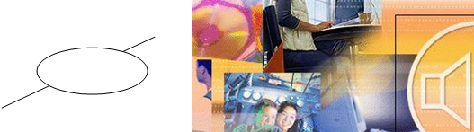
Graphics Overview - 5
Video modes: Video card can work in two mode:
  Text mode: The monitor is divided into a grid of large elements for presenting characters and each character is presented in one element. So, images can not be presented.
  Graphic mode: The monitor is divided into a grid of small or tiny elements. So, images can be presented on it.
Text Mode
Graph Mode

Slide 11
Graphics Overview - 6
Coordinates
0,0
x
y
x
y
Common use co-ordinates
Device co-ordinates
Types of graphics:
  Shapes: points, lines, shapes, polygons, colored shapes (vector graphics)
  Photos (raster graphics)

Slide 12
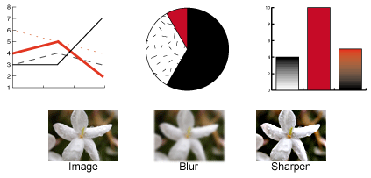
Introduction to Java 2D Graphics
Java 2D can:
  Draw lines, rectangles and any other geometric shape.
  Fill those shapes with solid colors or gradients and textures.
  Draw text with options for fine control over the font and rendering process.
  Draw images, optionally applying filtering operations.
  Apply operations such as compositing and transforming during any of the above rendering operations.

Slide 13
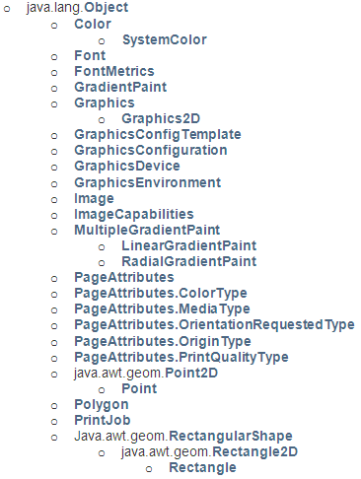

Java 2D Graphics APIs - 1
Package java.awt: Basic classes for drawing
The Graphics, Graphics2D classes are abstract
➔ we can not use it directly.
Each class representing a component in the packages java.awt, javax.swing implemented the method getGrahics() to get the appropriate concrete graphic objects which associate with it. This component plays a role as a drawing frame.
Casting a Graphics object to get a Graphics2D object.

Slide 14
Java 2D Graphics API's - 2
Package java.awt.geom: concrete classes for geometry
AffineTransform
Area
CubicCurve2D
  CubicCurve2D.Double
  CubicCurve2D.Float
Dimension2D
FlatteningPathIterator
Line2D
  Line2D.Double
  Line2D.Float
Path2D
  Path2D.Double
  Path2D.Float
    GeneralPath
Point2D
  Point2D.Double
  Point2D.Float
QuadCurve2D
  QuadCurve2D.Double
  QuadCurve2D.Float
RectangularShape
  Arc2D
    Arc2D.Double
    Arc2D.Float
  Ellipse2D
    Ellipse2D.Double
    Ellipse2D.Float
  Rectangle2D
    Rectangle2D.Double
    Rectangle2D.Float
  RoundRectangle2D
    RoundRectangle2D.Double
    RoundRectangle2D.Float
Quadratic: A curve of the second degree
Cubic Curves: A curve of the third degree

Slide 15
Graphics versus Graphics2D
void drawLine(int x1, int y1, int x2, int y2)
void drawOval(int x, int y, int width, int height)
void drawPolygon(int[] xPoints, int[] yPoints, int nPoints).
void drawPolygon(Polygon p)
void drawPolyline(int[] xPoints, int[] yPoints, int nPoints)
void drawRect(int x, int y, int width, int height)
void drawRoundRect(int x,int y,int width,int height,int arcWidth,int arcHeight)
The Graphics class has drawing methods based on values
The Graphics2 class inherits methods from the Graphics class and drawing methods based on shape objects and special methods are implemented such as rotate (quay ảnh), scale(co dãn), shear(làm nghiêng) , transform (biến hình), translate (chuyển dịch điểm)
void draw(Shape s)
void clip(Shape s)
void fill(Shape s)
void rotate(double theta)
void rotate(double theta, double x, double y)
void scale(double sx, double sy)
void shear(double shx, double shy)
void transform(AffineTransform Tx)
void translate(double tx, double ty)
void translate(int x, int y)

Slide 16
The java.awt.Color class
Static constants for basic colors: black, BLACK, red, RED, pink, PINK, orange, ORANGE, …
Common Constructors:
Color(int r, int g, int b), range 0-255
Color(int r, int g, int b, int a), r, g, b, alpha: 0-255
Color(float r, float g, float b), range: 0.0 - 1.0
Color(float r, float g, float b, float a), range 0.0-1.0
Alpha: level of transparency

Slide 17
How to Draw?
Drawing as soon as GUIs appear:
  Override the method paint(Graphics g). This method will be called as default when the class is loaded to draw it.
  Re-draw:
    - Call the method update(Graphics g) or repaint(void)
Free Drawing:
  Graphics g = Component.getGraphics();
  g.drawXXX(params)

Slide 18

Graphics class's methods
Method name | Description
drawImage(Image, x, y, [w, h], panel) | an image at the given x/y position and size
drawLine(x1, y1, x2, y2) | line between points (x1, y1), (x2, y2)
drawOval(x, y, width, height) | outline largest oval that fits in a box of size width * height with top-left at (x, y)
drawRect(x, y, width, height) | outline of rectangle of size width * height with top-left at (x, y)
drawString(text, x, y) | text with bottom-left at (x, y)
fillOval(x, y, width, height) | fill largest oval that fits in a box of size width * height with top-left at (x, y)
fillRect(x, y, width, height) | fill rectangle of size width * height with top-left at (x, y)
setColor(color) | paint any following shapes in the given color
setFont(font) | draw any following text with the given font

Slide 19
Graphics2D class
The Graphics object g passed to paint is a "graphical context" object to draw on the component.
  The actual object passed in is a Graphics2D (can cast).
  Graphics2D g2 = (Graphics2D) g;
Graphics2D is a subclass of Graphics that adds new features, new shapes, matrix transformations, color gradients, etc.
  Added to Java in v1.2 to improve on the features of Graphics.
  Why didn't they just add the new methods and features to Graphics directly? Why did they bother to make it a separate class?
    Answer: Open-Closed Principle. Graphics already worked just fine.
    Why risk breaking it by adding new features to the same file?

Slide 20
Graphics2D class's methods - 1
method name | description
draw(Shape) | draws the outline of a given shape object (replaces drawRect, etc.)
fill(Shape) | draws the outline and interior of a given shape object
getPaint(), setPaint(Paint) | returns or sets the current paint used for drawing (Color is one kind of Paint, but there are others)
getStroke(), setStroke(Stroke) | returns or sets the current line stroke style used for drawing (can be thin/thick, solid/dashed/dotted, etc.)
rotate(angle) | rotates any future drawn shapes by the given angle (radians)
scale(sx, sy) | resizes any future drawn shapes by the given x/y factors
translate(dx, dy) | moves any future drawn shapes by the given x/y amounts
setRenderingHint( key, value) | sets "rendering hints" such as anti-aliasing and smoothing
shear(shx, shy) | gives a slanted perspective to future drawn shapes
transform(t) | adds a transformation that will be applied to all shapes

Slide 21
Graphics2D class's methods - 2
method name | description
draw(Shape) | draws the outline of a given shape object (replaces drawRect, etc.)
fill(Shape) | draws the outline and interior of a given shape object
getPaint(), setPaint(Paint) | returns or sets the current paint used for drawing (Color is one kind of Paint, but there are others)
getStroke(), setStroke(Stroke) | returns or sets the current line stroke style used for drawing (can be thin/thick, solid/dashed/dotted, etc.)
rotate(angle) | rotates any future drawn shapes by the given angle (radians)
scale(sx, sy) | resizes any future drawn shapes by the given x/y factors
translate(dx, dy) | moves any future drawn shapes by the given x/y amounts
setRenderingHint( key, value) | sets "rendering hints" such as anti-aliasing and smoothing
shear(shx, shy) | gives a slanted perspective to future drawn shapes
transform(t) | adds a transformation that will be applied to all shapes

Slide 22






Shapes (java.awt.geom)
Arc2D.Double(x, y, w, h, start, extent, type)
An arc, which is a portion of an ellipse.
Ellipse2D.Double(x, y, w, h)
Line2D.Double(x1, y1, x2, y2)
Line2D.Double(p1, p2)
A line between two points.
Rectangle2D.Double(x, y, w, h)
RoundRectangle2D.Double(x, y, w, h, arcx, arcy)
GeneralPath()
A customizable polygon.

Slide 23
Methods of all shapes
method name | description
contains(x, y) contains(point) contains(rectangle) | whether the given point is inside the bounds of this shape
getBounds() | a rectangle representing the bounding box around this shape
getCenterX/Y() getMinX/Y() getMaxX/Y() | various corner or center coordinates within the shape
intersects(x,y,w,h) intersects(rectangle) | whether this shape touches the given rectangular region

Slide 24
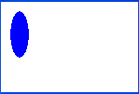
Drawing with objects
class MyCanvas extends JPanel {
public void paint(Graphics g) {
super.paint(g); // (1)
setBackground(Color.YELLOW); // without (1) no effect
Graphics2D g2 = (Graphics2D) g;
Shape shape = new Ellipse2D.Double(10, 10, 20, 50);
g2.setColor(Color.BLUE);
g2.fill(shape);
}
}

Slide 25
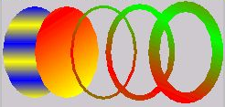
Colors and paints
Color (a simple single-colored paint)
  public Color(int r, int g, int b)
  public Color(int r, int g, int b, int alpha)
    a partially-transparent color (range 0-255, 0=transparent)
GradientPaint (a smooth transition between 2 colors)
  public GradientPaint(float x1, float y1, Color
  color1, float x2, float y2, Color color2)
java.awt.TexturePaint
(use an image as a "paint" background)

Slide 26
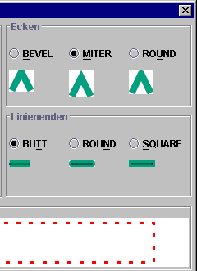
Strokes (pen styles)
Graphics2D
  public void setStroke(Stroke s)
  Sets type of drawing pen (color, width, style)
  that will be used by this Graphics2D.
BasicStroke
A pen stroke for drawing outlines.
  public BasicStroke(float width)
  public BasicStroke(float width, int cap, int join)
  public BasicStroke(float width, int cap,
  int join, float miterlimit,
  float[] dash, float dash_phase)
    cap can be: CAP_BUTT, CAP_ROUND, CAP_SQUARE
    join can be: JOIN_BEVEL, JOIN_MITER, JOIN_ROUND

Slide 27
Repainting
Most canvases are drawing the state of fields, a model, etc.
  When the state updates, you must tell the canvas to re-draw itself.
  But you can't call its paintComponent method, because you don't have the Graphics g to pass.
  The proper way is to call repaint on the canvas instead:
  public void repaint()
    ...
    public void update(Observable o, Object arg) {
    myView.repaint(); // perhaps this.repaint();
    }

Slide 28
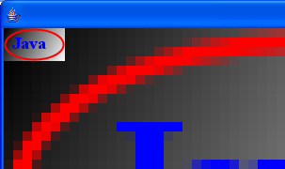
Anti-aliasing
Onscreen text and shapes can have jagged edges, or aliases. These can be removed by smoothing, or anti-aliasing, the component.
  public void setRenderingHint(key, value)
  Example:
  g2.setRenderingHint(
  RenderingHints.KEY_ANTIALIASING,
  RenderingHints.VALUE_ANTIALIAS_ON);

Slide 29
Creating images
// import java.awt.image.*;
BufferedImage
A blank graphic image buffer surface onto which you can draw
  public BufferedImage(int w, int h, int type)
    where type is a constant such as BufferedImage.TYPE_INT_ARGB
  public Graphics getGraphics()
    returns a graphical pen for "drawing on" this image
  you can draw a BufferedImage onto the screen from within the paintComponent method of your canvas:
    g.drawImage(BufferedImage, x, y, this);

Slide 30
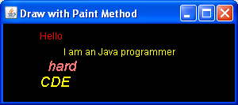
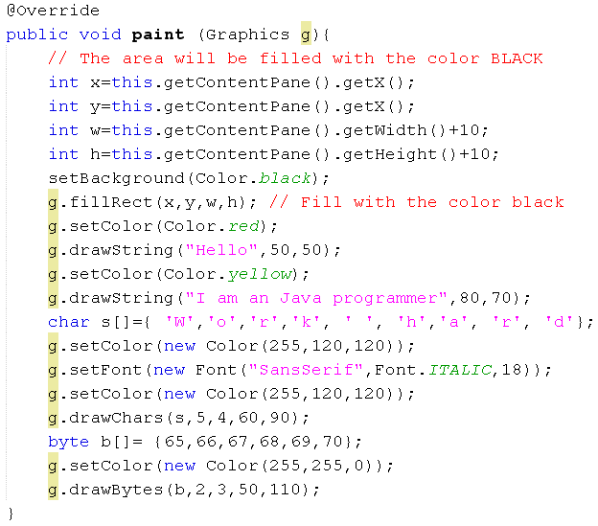

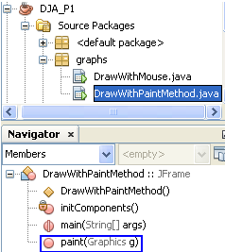
Demo 1: Using the method paint(…)
Frame properties:
title: Draw with Paint Method
Layout: Border
Size: 300, 150

Slide 31
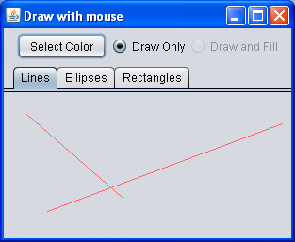
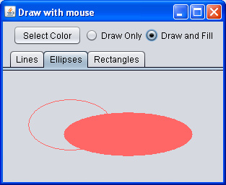
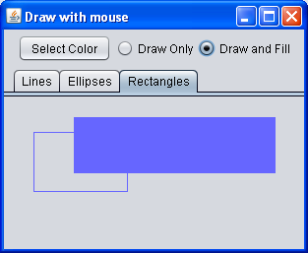
Demo 2 - 1: Drawing with Mouse
The following demonstration will depict how to draw shapes using mouse events.
A shape is determined by two points: p1 (when user presses the mouse) and p2 (when user releases the mouse).
If an ellipse or a rectangle is chosen, from p1 and p2, the drawing area is determined appropriately.
Left,top
width
p2
height
p1

Slide 32
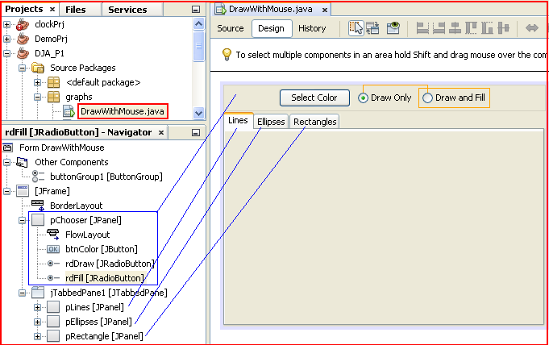
Demo 2 - 2: Design
Frame properties
Title: Draw with mouse
The panel pChooser is put to the direction NORTH of the frame
The tabbedpane jTabbedPane1 is put to the direction CENTER of the frame

Slide 33
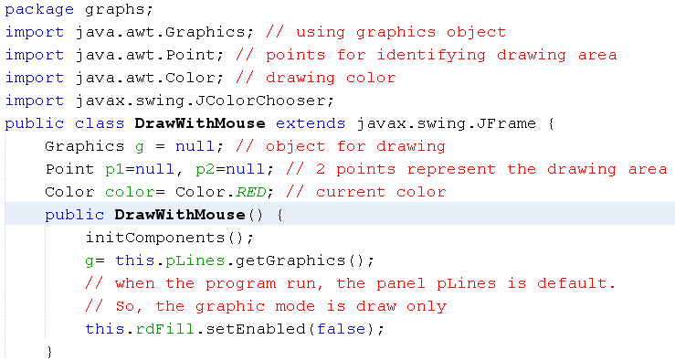
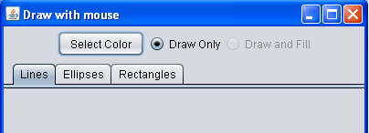
Demo 2 - 3: Code

Slide 34
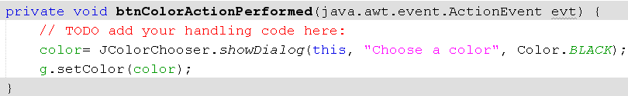

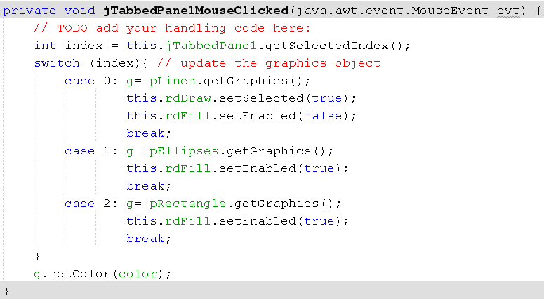
Demo 2 - 4: Code

Slide 35

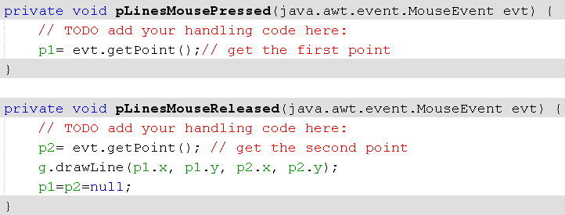
Demo 2 - 5: Code

Slide 36


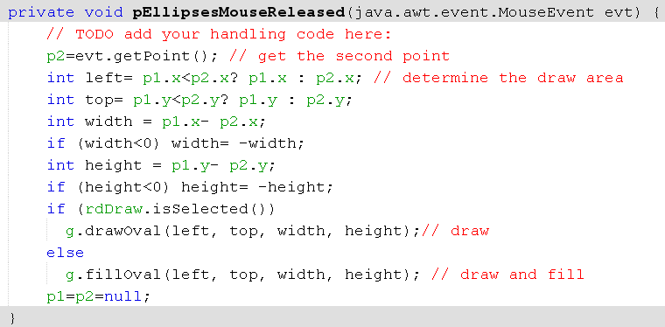
Demo 2 - 6: Code

Slide 37


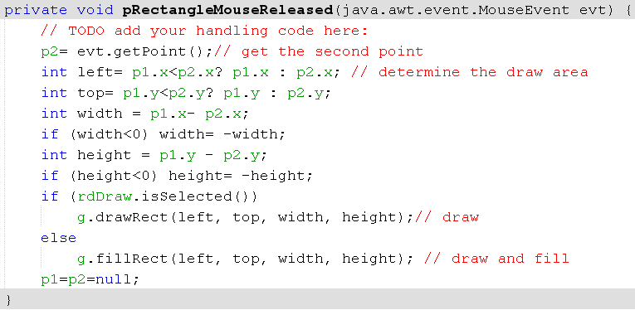
Demo 2 - 7: Code

Slide 38
Summary
Graphics Overview
Introduction to Java 2D Graphics
2D Graphics APIs
How to Draw?
Demonstrations

